Slide 1
LSDG – V&C Vrtualisation & CONTAINiSAtion
JP McGinty 2019 ©
Virtualization and containerization in software development

Slide 2
AGENDA
Talk: Shipping Containers – to virtualization and containers are changing software development
The formation of Scrum
Agile Manifesto
Rise of Scrum
Scaling Scrum and Agile
Discussion: TBSCall sprints should be 1 calendar month
Dev Intro: Running Docker
Drinks / Networking

Slide 3

Thank you
Notes:
This is the first London Software Development Group meetup.
I know there are many other things you could be doing this evening so I’m grateful that you have decided to come along and at least listen

Slide 4

VIRTUALISATION in Development

Slide 5

WHY?

Slide 6


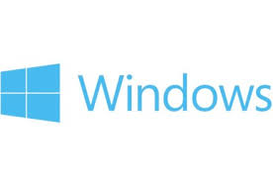
Developer: MULTIPLE OPERATING SYSTEMS to Play on
Development
Testing: newer/older OS, different OS
Playing
Security

Slide 7
Basic computer terminology
Application – User initiated programs e.g.MS Powerpoint
Operating System (OS) – programs and services created to run the OS e.g. Windows
Firmware – programs to control the hardware with the operating system e.g. BIOS
Hardware – physical machinery that allows the computer to function e.g. Central Processing Unit (CPU)
Note: Computer has multiple versions of this stack to operate e.g. video controller is a computer within a computer.
APPLICATION
OPERATING SYSTEM
FIRMWARE
HARDWARE

Slide 8
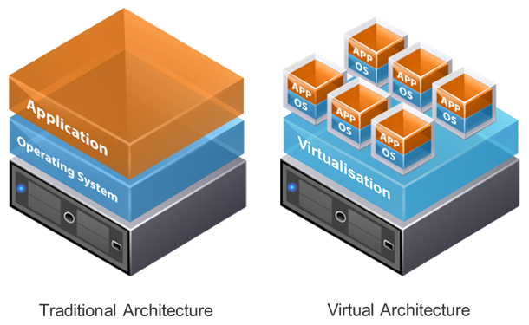
Potted history of virtualisation
Started in 1960s with the segregation of main frame computers (IBM VM Mainframe)
1980s – 1990s saw the introduction of multiple operating systems (OS) and the creation of client-server topology.
2000s virtualisation of client machines possible due to availability of x86 chips
Now cloud virtualisation
Source: IT FUEL: https://www.itfuel.com/blog/9/virtualisation-in-laymans-terms-for-the-smaller-organisation/

Slide 9
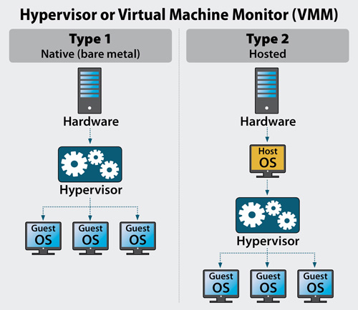
Virtualisation not just dev Playgrounds TYPE 1, TYPE II and HYPervisor
Two types of virtualisation
Both controlled by a HYPERVISOR
I – Native or Bare Metal
Hypervisor divides hardware up into virtual machines
Server virtualisation and IaaS
II – Hosted or Host Guest
Hypervisor divides hosted OS into Guest VMs.
Developer virtualisation
Source: Server Watch, Nov 2018, https://www.serverwatch.com/server-trends/guide-to-hypervisors.html
Notes:
At a deeper level, a hypervisor is a process – consisting of software, hardware or firmware – that runs on physical hosts to create virtual machines. These VMs act as independent application servers, though in fact they share the host’s CPU cycles, memory, and bandwidth. The hypervisor spins up, provisions, and retires them as required. This action of spinning up, provisioning and retire is the "manager" role mentioned above.

Slide 10
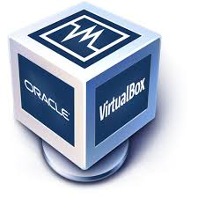

Example: Linux (ubuntu) on Windows
Windows like to run Windows things (this is changing)
Running Linux allows other programming languages to be tried
Install VirtualBox (Oracle)
Download Ubuntu 18.04.
APPLICATION
OS
VM
APPLICATION
OPERATING SYSTEM
FIRMWARE
HARDWARE

Slide 11


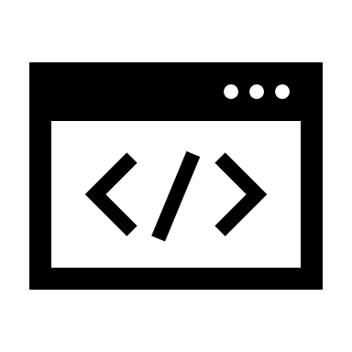


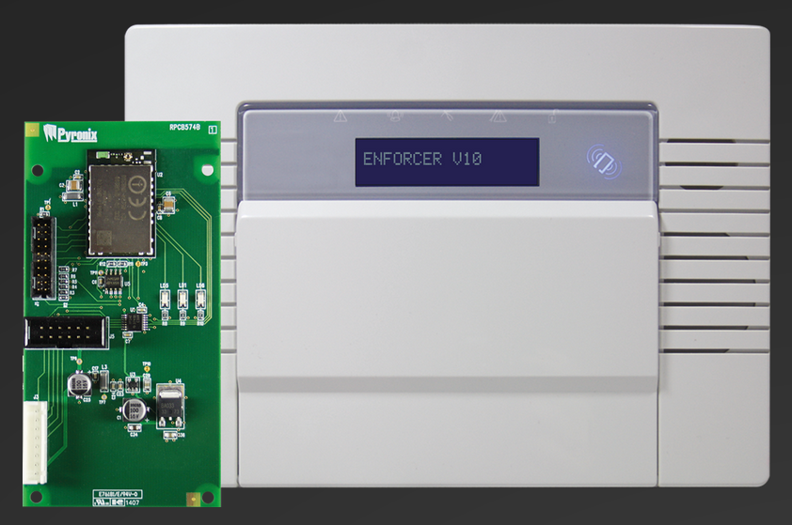






Real world example – DARREN LUCAS WINDOWS host, Linux Guest – Firmware upgrade
Windows OS – comes with the PC, Corporate office software
Linux Ubutu OS – development environment
VirtualBox – Hypervisor that manages Ubutu
Linux VM is totally separate from the Windows OS and network system
1. Developer writes code on Linux OS and saves to external drive (not a floppy disk!)
2. Program transported by field engineer and used to update firmware of computer
3. Firmware updated and device upgraded/secured etc

Slide 12
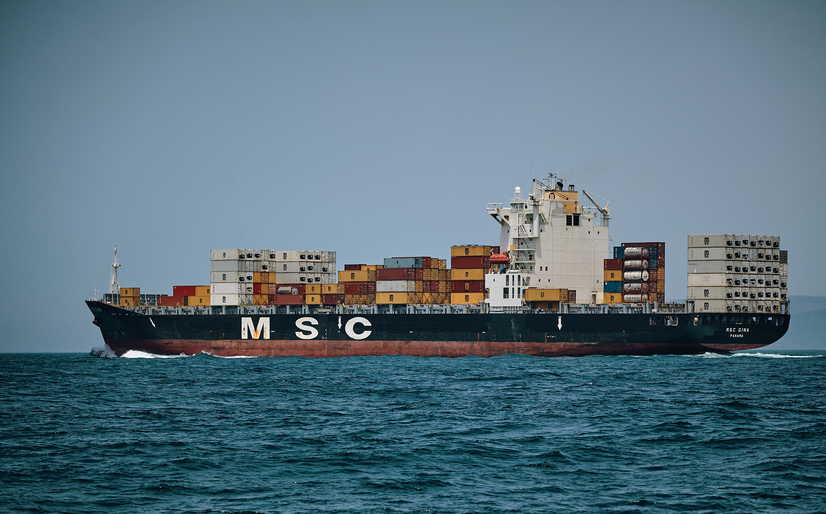
CONTAINISATION in Development

Slide 13
Why would containers be helpful to a developer?
Development
Testing: newer/older OS, different OS
Playing
Security

Slide 14
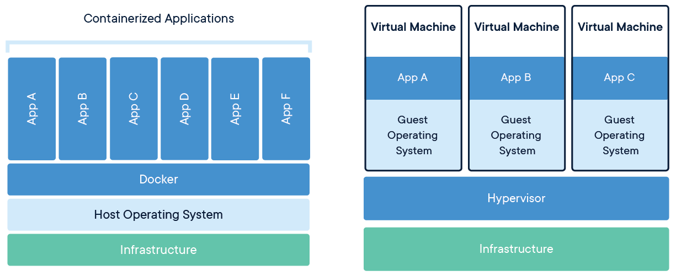
What is a container?
Docker: a standardized unit of software
Source: Docker - Whttps://www.docker.com/resources/what-container

Slide 15
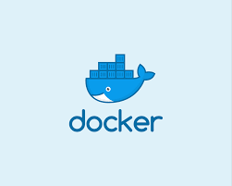
Real world DEMO on DOCKER CONTAINER DAFYDD REES

Slide 16
Bit More DETAIL
RUNTIME
IMAGE
OS: Linux
“Contained” Processes
Separate from the other processes on the OS
Sandboxed: own process name space
And C Groups
Shell into container – use the one Process
When the container starts the process starts and vice versa
Container and Process Lifecycle the same
Processes – shared address and name space
P
P
P
P
Processes – shared address and name space
P
P
P
FIRMWARE

Slide 17
Thank you
Notes:
This is the first London Software Development Group meetup.
I know there are many other things you could be doing this evening so I’m grateful that you have decided to come along and at least listen

Slide 18
NEtwork
Notes:
Consider talking about:
Individuals

